Slide 1
Bienvenidos

Slide 2
¡Felicidades!
Pasos a seguir:
Confirmar matrícula en o antes del 1ro de mayo (pagar la cuota de matrícula)
Aplicar para alojamiento en el recinto o someter Commuter Exemption (para estudiantes que vivirán con sus padres)
disponible desde el 1ro de febrero
Asistir a un Golden Flash Day (febrero - april)
Registrarse para asistir a Destination Kent State: Advising & Registration (DKS) disponible desde el 1ro de marzo
Notes:
January 23

Slide 3
Objetivos
Becas
Proceso de oferta
Programas de asistencia económica
Proceso de pago
FAFSA en línea

Slide 4
Becas

Slide 5
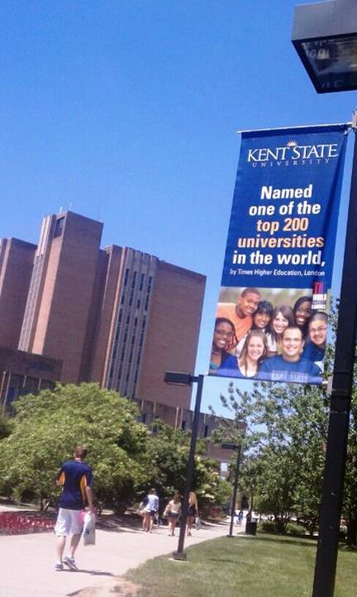
Becas para estudiantes de nuevo ingreso
La eligibilidad es basada en la solicitud de admisión a Kent State antes del 15 de enero del 2016
Varia desde $1,000 a cubrir la matrícula completa
www.kent.edu/admissions
Notes:
Joint effort between Admissions, SFA and Honors
Review each briefly

Slide 6
Becas para estudiantes de nuevo ingreso
Trustee Scholarship
Oscar Ritchie Memorial Scholarship
University Award
Presidents Scholarship
Presidents Grant
Honors College Scholarships
Founders Scholarships

Slide 7
Becas para estudiantes de nuevo ingreso
Trustee
Founders
Oscar Ritchie Memorial
Los requisitos de puntuación de GPA/Exámen varian
Mínimo 12 créditos Recinto de Kent Renovable por 4 años (8 semestres)
Notes:
8 semesters
Trustee is the largest, $1000-$5000 , split Fall/Spring
Founders (donor) - Premier, amount awarded changes each year, $500 - Full
Oscar Richie - underrepresented African American, Latino and native American, $3000

Slide 8
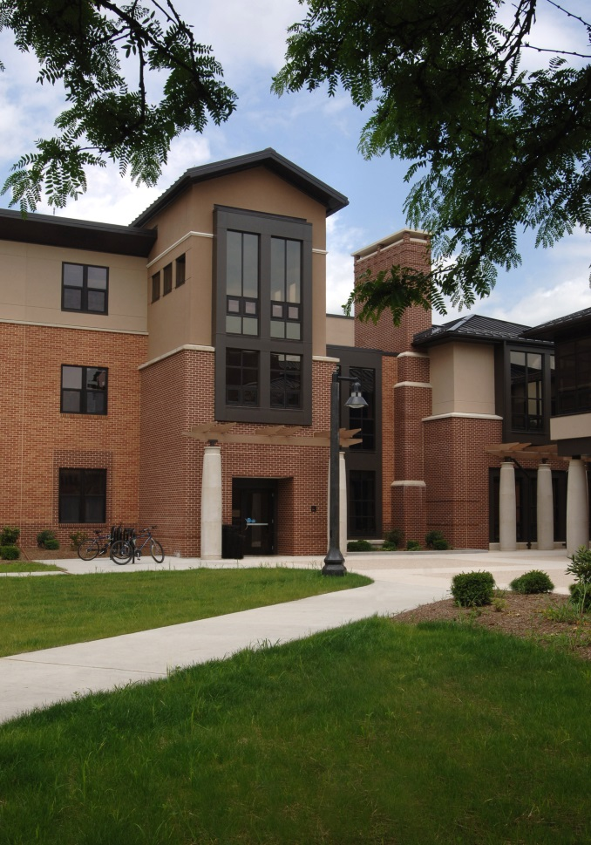
Becas de Honors College
Disponible para estudiantes de nuevo ingreso que se les ha concedido la admisión al Honors College
Se requiere una aplicación adicional en o antes del 1ro de mayo del 2016
Estudiantes del Recinto de Kent
Número de contacto: 330-672-2312
Correo electrónico: honors@kent.edu
Notes:
Invited to apply to Honors College - application and essay
Contact Honors for more information

Slide 9
Becas para estudianes no residentes
University Award
President’s Scholarship
President’s Grant
La mitad del cargo adicional para estudiantes no residentes
Mínimo 12 créditos Recinto de Kent Renovable por 4 años (8 semestres)
$4,100
Basado en candidades del 2015 - 2016
Notes:
Grant is child/step-child of KSU alumni

Slide 10
El estudiante debe
aceptar o declinar
las becas en FlashLine
en o antes del 1ro de mayo
Notes:
National College Decision Day

Slide 11
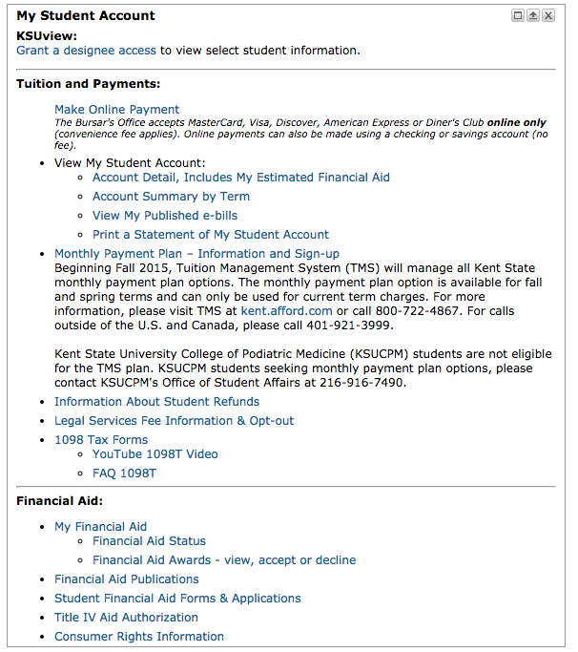
Seleccione
“My Account”
Para ver la asistencia económica ofrecida en FlashLine
Notes:
FlashLine is Student Portal
Student has option to Accept, Decline or Accept Partial Amount

Slide 12
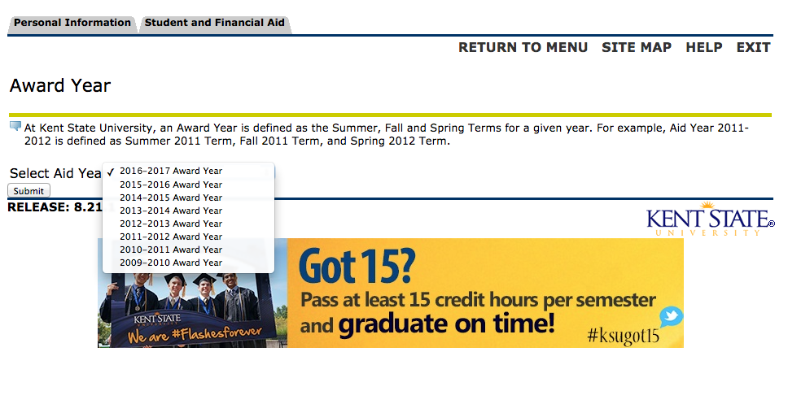
Notes:
FlashLine is Student Portal
Student has option to Accept, Decline or Accept Partial Amount

Slide 13
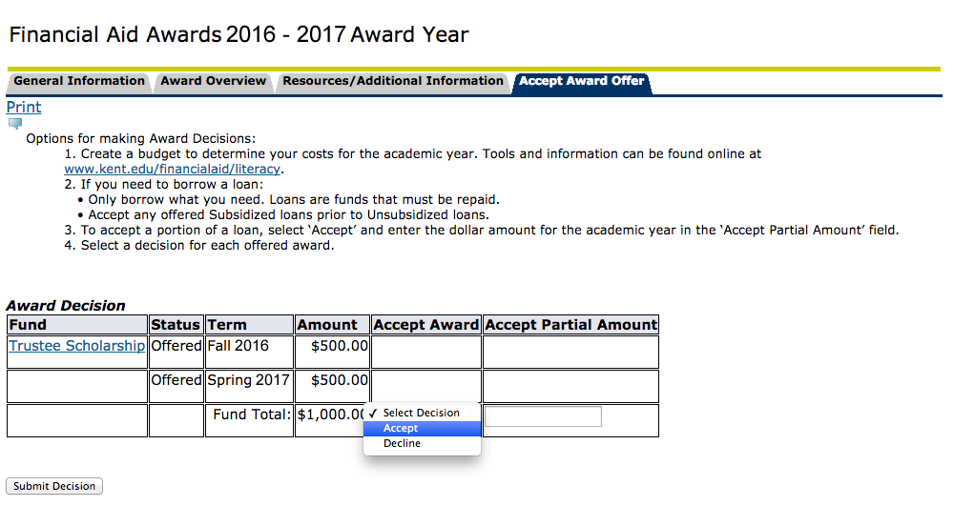
Notes:
FlashLine is Student Portal
Student has option to Accept, Decline or Accept Partial Amount

Slide 14
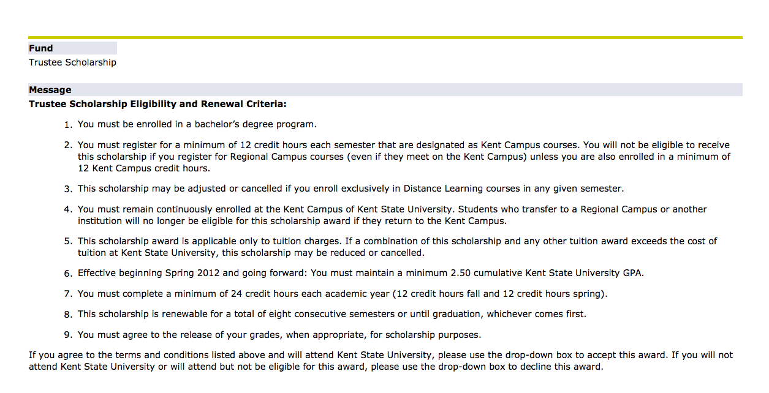
Notes:
FlashLine is Student Portal
Student has option to Accept, Decline or Accept Partial Amount

Slide 15
Becas departamentales
Ofrecidas por los departamentos
académicos
Contacte el departamento académico específico para información y la fecha límite para aplicar
www.kent.edu/financialaid/scholarships
Notes:
Departmental scholarships are based primarily on students intended major of study - specific major

Slide 16
Becas ROTC
U.S. Army ROTC
Contacte al Unit Admissions Officer
330-672-ARMY
U.S. Air Force ROTC
Contacte al Unit Admissions Officer
330-672-2182
Notes:
Tuition or room and board stipend or scholarship

Slide 17
Becas STEM
Hasta $5,000 por año
Debe completar la FAFSA y demostrar necesidad
Debe ser ciudadano americano
La aplicación está disponible a principios de
marzo
www.stem-scholarships.kent.edu
Notes:
Federal grant that KSU receives
For students pursuing a bachelor of science in: (medical professions are ineligible)
Computer Science
Chemistry
Physics
Geology
Biology
Mathematics

Slide 18
Becas de Atletismo
Notes:
14 different scholarships
Mens: Baseball, Basketball, Track & Field, Golf, Cross Country, Football, Wrestling
Women’s: Softball, Basketball, Track & Field, Soccer, Golf, Cross Country, Field Hockey, Gymnastics, and Volleyball

Slide 19
Becas de Atletismo
NCAA División I
Completar
el perfil de
reclutamiento
www.kentstatesports.com
Notes:
If no contact with coaching staff yet, complete recruiting profile. High school coach to reach out to school.

Slide 20
Programa de Igualar Becas
Igualamos cualquier beca externa hasta $1000
Para estudiantes de nuevo ingregro matrículados
a tiempo completo en el Recinto de Kent
Completar la FAFSA
EFC de 8,000 o menos
Notes:
Enrolled in a bachelor’s degree program
Register for at least 12 credit hours each semester
Non-renewable
Awards split evenly between fall and spring semesters
Applicable to tuition charges only

Slide 21
Ejemplo:
Se divide en partes iguales entre los
semestres
La cantidad igualada no es renovable
La aplicación debe ser completada en o
antes del 1ro de noviembre del 2016
$500 Beca Club Rotario
$500 Beca Banco Local
$250 Beca Banda Escuela
Superior
_____________________
$1250 Total
¡Más!
$1000 Kent State
Programa de Igualar
Becas
_____________________
$2250 Total
www.kent.edu/financialaid/scholarshipmatch

Slide 22
Becas del estado de Ohio
www.ohiohighered.org
Ohio War Orphans Scholarship
Choose Ohio First Scholarship
Ohio National Guard Scholarship
Notes:
OWOS and ONG apply directly to OHE by July 1
COF awarded to hard sciences, science tech, engineering and math
Apply KSU online application

Slide 23
Consejo al momento de aplicar para becas
Comienze lo antes posible
Complete las aplicaciones
cuidadosamente
Conteste todas las preguntas
Atención a la fecha límite
Notes:
Start searching for scholarships while still in high school.
Discuss with counselors, teachers, neighbors, and relatives
Essays, answer questions/topic

Slide 24
Kent State Scholarship Search
Kent State University Búsqueda de Becas
www.kent.edu/financialaid/scholarship-search
Notes:
Portal for finding all KSU scholarships - over 700
Should complete search every couple of month for new opportunities
QR Code in your packet can direct you right to the search. Click the one under “Students”

Slide 25
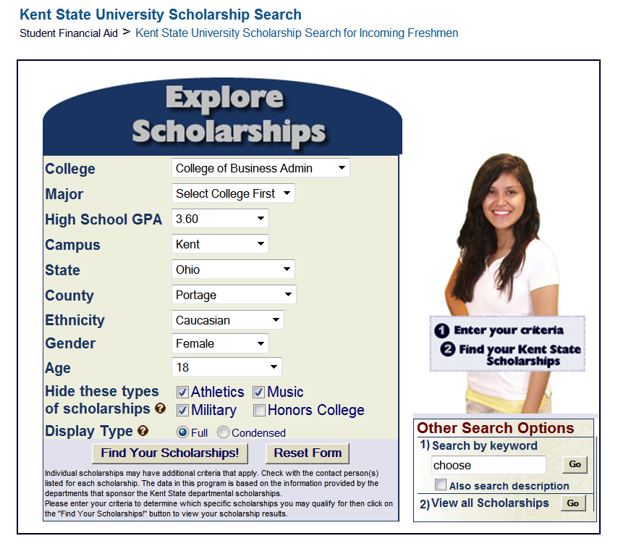
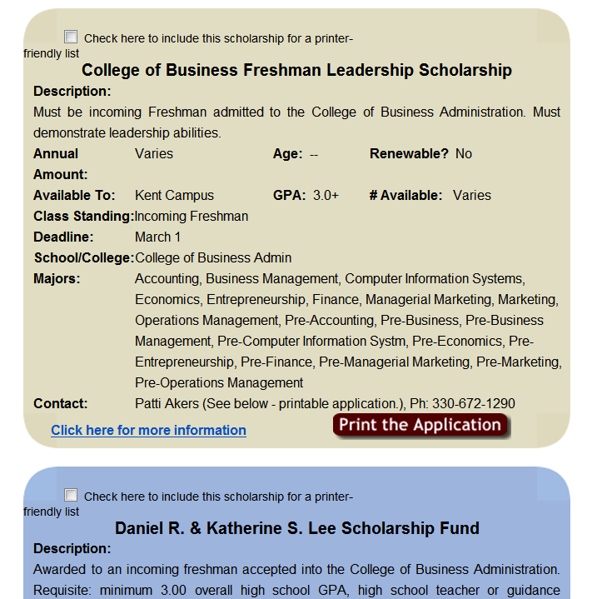
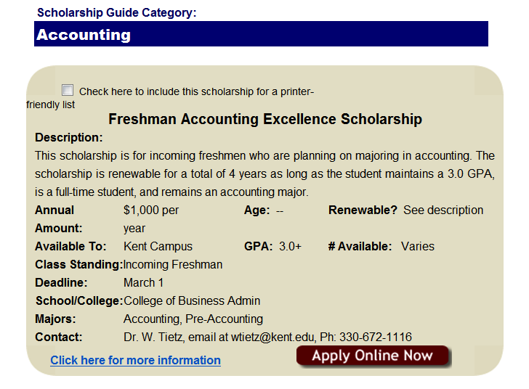

Slide 26
Proceso de oferta

Slide 27
Proceso de aplicación
febrero 2016
Sunday | Monday | Tuesday | Wednesday | Thursday | Friday | Saturday
 | 1 | 2 | 3 | 4 | 5 | 6
7 | 8 | 9 | 10 | 11 | 12 | 13
14 | 15 | 16 | 17 | 18 | 19 | 20
21 | 22 | 23 | 24 | 25 | 26 | 27
28 | 29
Completar la FAFSA en o antes del 15 de febrero
Notes:
Complete the FAFSA online by February 15, 2016 to meet Kent State University’s “Priority Processing Date” of March 1, 2016 (NEXT SLIDE)

Slide 28
Proceso de aplicación
marzo 2016
Sunday | Monday | Tuesday | Wednesday | Thursday | Friday | Saturday
 |  | 1 | 2 | 3 | 4 | 5
6 | 7 | 8 | 9 | 10 | 11 | 12
13 | 14 | 15 | 16 | 17 | 18 | 19
20 | 21 | 22 | 23 | 24 | 25 | 26
27 | 28 | 29 | 30 | 31
Fecha de prioridad 1ro de marzo

Slide 29
Proceso de aplicación verano
Fecha de prioridad
15 de marzo
Debe estar matrículado en clases de verano antes de que la aplicación sea procesada
www.kent.edu/financialaid/summer
Notes:
Must complete the 2016-2017 FAFSA
Summer bills are due May 18, 2016

Slide 30
Proceso de oferta
El estudiante recibirá
el Student Aid Report (SAR) electrónicamente o en papel
Universidad recibirá una versión electrónica del
Student Aid Report (SAR)

Slide 31
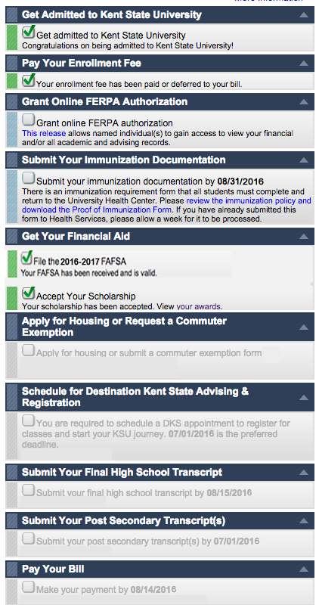
Ver su lista de preparación
La puede encontrar en
New@KSU
en FlashLine

Slide 32
Acceso a padres y familiares
KSUview Designee
Permite, a la persona designada, ver información escogidida en FlashLine
www.kent.edu/welcome-ksuview
FERPA Release Form Designee
Permite, a la persona designada, contactar KSU para recibir información sobre la cuenta del estudiante
www.kent.edu/about-ferpa
Debe ser completado por el estudiante en FlashLine
Bajo la etiqueta Student Tools & Courses

Slide 33
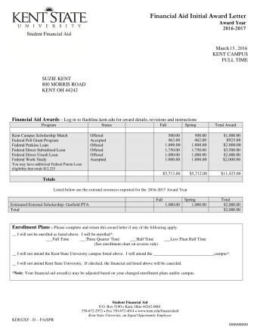
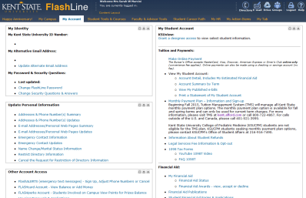
Kent State procesa la información a través de el Programa de oferta
Los estudiantes de nuevo ingreso recibirán ,via email y por correo, la
Carta de oferta
Los estudiantes puede ver su asistencia económica disponible en FlashLine

Slide 34
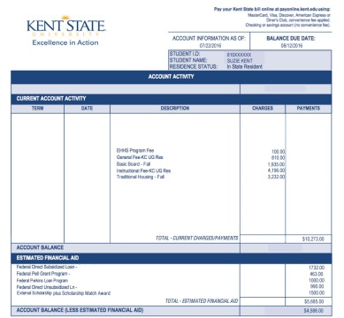
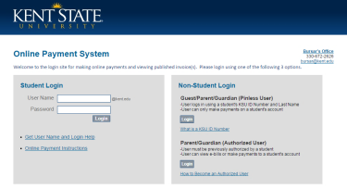
Kent State
publica
La factura electrónica del semestre el
22 de julio
La asistencia económica aparece como un crédito en la cuenta del estudiante
De haber un balance en la cuenta del estudiante, este se reflejará en el Bursar’s Office

Slide 35
¿Qué determina la necesidad económica?
FAFSA
Becas
Matrícula
Transportación
Alojamiento
EFC
COA

Slide 36
FAFSA
Base de datos
No debe tener errores

Slide 37
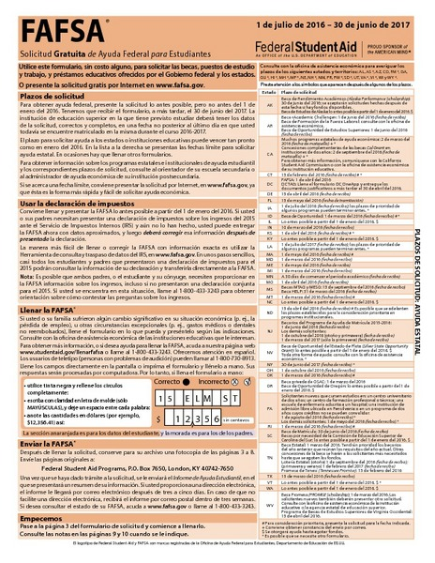
Administración del Seguro Social
Servicio Selectivo
Administración de Veteranos
El Sistema Nacional de Información sobre los Préstamos Educativos
(NSLDS)
Departamento de Seguridad Nacional

Slide 38
FAFSA
Sin errores
EFC
Contribución Familiar Esperada
(Expected Family Contribution)
Notes:
An error free FAFSA will confirm the Expected Family Contribution (EFC)

Slide 39
Determina la eligibilidad para varios tipos de asistencia económica

Slide 40
EFC
Contribución de los padres
Contribución del estudiante
Ingreso disponible
Ingreso disponible
Activos disponible
Activos disponible
Notes:
Contribution = Available Income + Available Assets

Slide 41
Ejemplo de un estudiante con baja necesidad
Familia de 4
Ingreso Bruto Ajustado de los padres $130,000
Ingreso Bruto Ajustado del estudiante $0
Activos de los padres $10,000
Activos del estudiante $2,000
EFC del Estudiante= 21,958
Notes:
Scenario 1:
Family of 4, 1 in college.
$130,000 parent AGI
$0 student AGI
$10,000 parent assets
$2,000 student assets

Slide 42
Ejemplo de un estudiante con alta necesidad
Familia de 4
Ingreso Bruto Ajustado de los padres $60,000
Ingreso Bruto Ajustado del estudiante $0
Activos de los padres $5,000
Activos del estudiante $2,000
EFC del estudiante = 4,816
Notes:
Scenario 2:
Family of 4, 1 in college.
$60,000 parent AGI
$0 student AGI
$5,000 parent assets
$2,000 student assets

Slide 43
Ejemplo de dos estudiantes en el hogar
Familia de 4
Ingreso Bruto Ajustado de los padres $60,000
Activos de los padres $5,000
Ingreso Bruto Ajustado del estudiante 1 $0
Activos del estudiante 1 $2,000
Ingreso Bruto Ajustado del estudiante 2 $2,000
Activos del estudiante 2 $3,000
EFC = 3,042
EFC = 3,242
Notes:
Scenario 3:
Family of 4, 2 in college
$60,000 parent AGI
$0 student 1 AGI
$3,000 student 2 AGI
$5,000 parent assets
$2,000 student 1 assets
$3,000 student 2 assets

Slide 44
Costo de Estudiar (Cost of Attendance)
Gastos directos e indirectos que contribuyen al
Costo de Estudiar

Slide 45
Costo de Estudiar
Residentes de
Ohio
No residentes de
Ohio
Matrícula*
Habitación doble estándar*
Plan de alimentación básico*
Libros y útiles escolares
Transportación
Gastos personales y misceláneos
$10,012
$6,464
$3,870
$1,408
$1,752
$2,144
$18,212
$6,464
$3,870
$1,408
$1,752
$2,144
*Costos directos basado en cantidades de 2015-2016
Notes:
Miscellaneous and Personal contains Loan Fees of $118

Slide 46
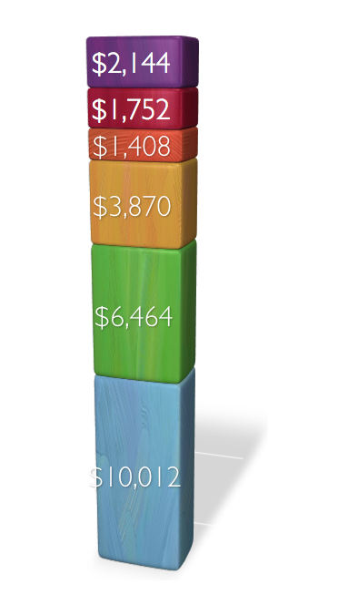
Ejemplo:
Costo de Estudiar estimado de Suzie Kent
$25,650
Matrícula
Habitación doble estándar
Plan de alimentación básico
Libros y útiles escolares
Transportación
Gastos personales y miscelaneós

Slide 47
Costo de Estudiar (COA)
Calcular la necesidad económica
Contribución Familiar Esperada(EFC)
Necesidad económica
(COA) Cost of Attendance
(EFC) Expected Family Contribution

Slide 48
Contribución Familiar Esperada (EFC) estimada de Suzie Kent es 4,816
Ejemplo:
$25, 650 (COA)
4,816 (EFC)
$20,834 Necesidad económica
Notes:
Break after this slide

Slide 49
Programas de asistencia económica

Slide 50
Tipos de ayuda
Becas
Préstamos
Programa de Estudio y
Trabajo
Notes:
Discover piece moves slides to right
QR Code for “Parents” goes to Types of Aid on studentaid.ed.gov

Slide 51
Becas federales
Beca Federal Pell
máximo $5,815
cantidad para 2016-2017
Beca TEACH
máximo $3,728
Teacher Education Assistance for College and Higher Education Grant
FSEOG
Residente máximo$1,200
Beca Federal Complementaria para la Oportunidad Educativa
No Residente máximo$2,000
Basado en cantidades del 2015-2016
Notes:
Reference that packet is incorrect with $5845. Actual amount is $5815.
Pell grant/ SEOG NEED BASED
Pell max EFC for 2015-2016 is 5198

Slide 52
Becas - estado
Ohio College Opportunity Grant (OCOG)
máximo $1,296
www.ohiohighered.org
Pennsylvania Higher Education
Assistance Agency (PHEAA)
máximo $554
www.pheaa.org
Basado en cantidades del 2015-2016

Slide 53
Otras oportunidades para recibir ayuda
Programa Federal de Estudio y Trabajo
Empleo financiado por la universidad
Contacte la Oficina de Career Services
www.kent.edu/career
Notes:
*Must indicate interested in work study on the FAFSA to be considered - Question 31 on the FAFSA

Slide 54
Préstamo Federal Perkins
Para estudiantes con necesidad económica
Tasa de interés fijo 5%
Máximo $2,000
El Gobierno Federal ha programado terminar el Programa Federal de Préstamos Perkins el 30 de septiembre de 2017. La disponibilidad del programa es incierta después de esa fecha.
Notes:
Program will end on September 30, 2017

Slide 55
Préstamos de enfermería
Préstamo Federal Estudiantil de Enfermería
Tasa de interés fijo 5%
Máximo $3,000
Nurse Education Assistance
Loan Program (NEALP)
Tasa de interés fijo 3%
Máximo $1,500
Una vez admitido formalmente en el Programa de Enfermería
Notes:
5 % interest rate
Repayment begins 9 months after student ceases half-time enrollment
Current interest rate for NEALP is 3%. Separate application must be filed with the Ohio Department of Higher Education between Jan1 and July 15 of each year.

Slide 56
Federal Direct Loans
Préstamos federales para estudiantes
Subsidiado
Para estudiantes con necesidad económica
No subsidiado
No requiere demostrar necesidad económica
Ambos tienen una tasa de interés fijo actual de 4.29%*
*La tasa de interés es establecida anualmente en julio 1ro
Notes:
Subsidized: For undergraduate loans disbursed after July 1, 2015
Unsubsidized: Interest accrues upon disbursement
Repayment begins 6 months after student ceases half-time enrollment

Slide 57
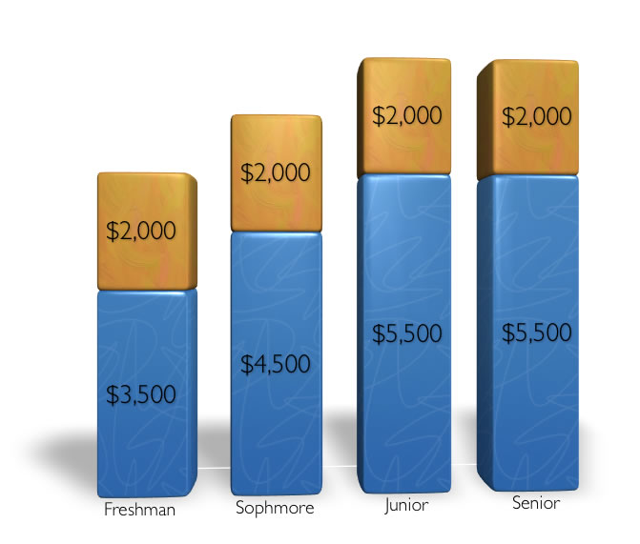
Límites anuales del Programa Federal
Direct Student Loan
Primer año: $5,500
Segundo año: $6,500
Tercer año: $7,500
Cuarto año: $7,500
Sophomore
Subsidiado (basado en necesidad) No Subsidiado
Notes:
Subsidized loan amount will be awarded based on remaining need determined by FAFSA results.

Slide 58
Límites del Direct Loan Program
Direct Loans = Máxima elegibilidad de $31,000*
Préstamo Subsidiado = Máximo de $23,000 y se limita a 6 años para un programa de bachillerato
* Límite estudiante dependiente

Slide 59
Límite de los Programas de Becas
Federales y Estatales
Beca Pell = 6 años de elegibilidad
(12 semestres a tiempo completo)
Beca TEACH = $16,000 como estudiante de pregrado ($3,728 current year max)
Ohio College
Opportunity Grant = 10 semestres a tiempo completo
Notes:
TEACH year max may change on October 1, 2016

Slide 60
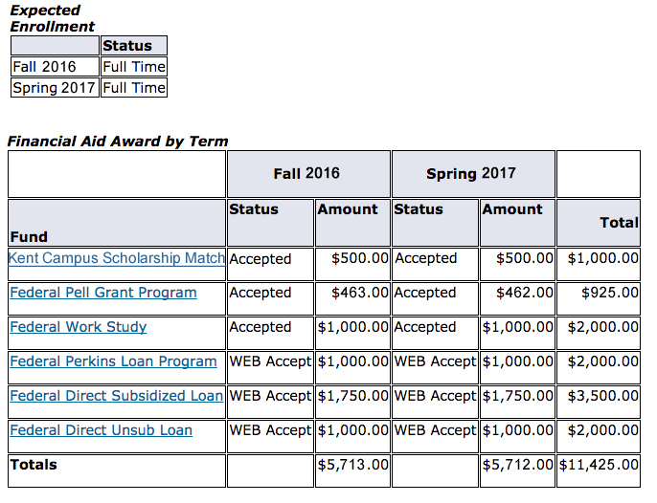
Ejemplos
de ofertas aceptadas
en
FlashLine
Notes:
Students must make a decision in FlashLine to Accept, Decline, or Accept Partial Amount

Slide 61
www.StudentLoans.gov
Para completer el Asesoramiento de Ingreso
(Entrance Loan Counseling)
y
Firmar el Pagaré Maestro (Master Promissory Note)

Slide 62
El estudiante debe completar
Asesoramiento de Ingreso
(Entrance Loan Counseling)
y
Pagaré Maestro
(Master Promissory Note)
Notes:
Both Entrance Counseling and completing the Master Promissory Note is done at www.studentloans.gov
You will need your FSAID Username/email and FSAID password
You will be given 3 different types of counseling options to complete. Be sure to complete the one titled “Entrance” counseling.

Slide 63
Préstamo Federal PLUS para padres prestatarios
Padre tiene que iniciar la sesión,
no el estudiante
Disponible desde el
1ro de junio del 2016
Notes:
Electronic application process for parent or step-parent on FAFSA
Must have completed a FAFSA
Use parent FSA ID and password
Approval contingent upon credit worthiness
4.272% origination fee as of Oct 1, 2015

Slide 64
Préstamo Federal PLUS para padres prestatarios

Slide 65
Préstamo Federal PLUS para padres prestatarios

Slide 66
Préstamo Federal PLUS para padres prestatarios
El estudiante debe completar la FAFSA
La aplicación está sujeta a aprovación de crédito
Aplazamiento de pago disponible
Tasa de interés fijo para el préstamo PLUS es 6.84% *
*La tasa de interés es establecida anualmente el 1ro de julio

Slide 67
Préstamos privados
Ayudan a los estudiantes a pagar
gastos educativos
además de la ayuda federal, estatal, e
institucional
Notes:
Can compare up to 5 loans at a time

Slide 68
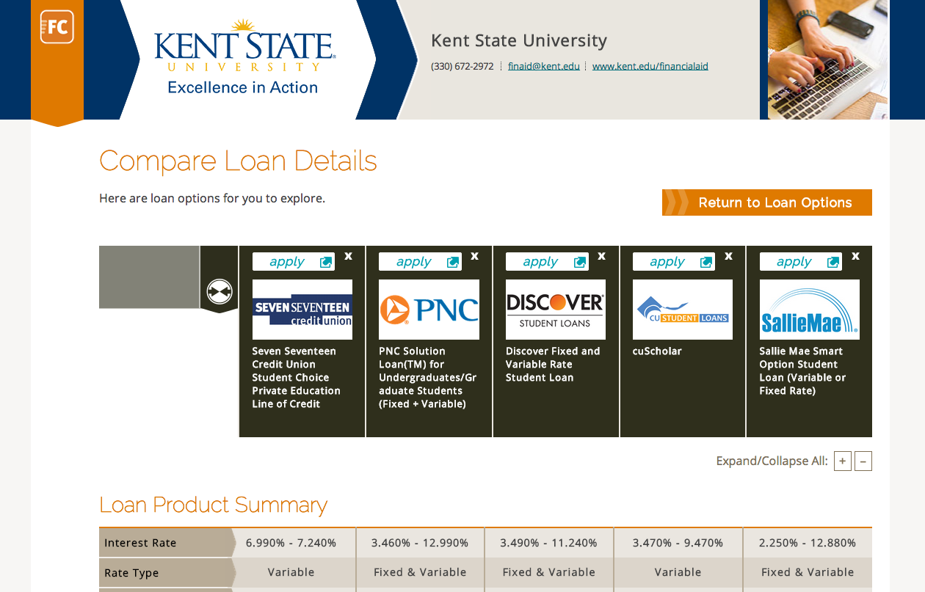
Préstamos privados
Fast Choice
Visite www.kent.edu/financialaid/fastchoice para
una lista de entidades créditicias
y para comparar opciones

Slide 69
Beneficios de educación para veteranos
Asistencia Educativa para Dependientes (Capítulo 35)
Post-9/11 GI Bill
Contacte a Dawn Plug
Center for Adult
and Veterans Services (CAVS)
330-672-7933
www.kent.edu/cavs

Slide 70
Mantener elegibilidad
Progreso Académico Satisfactorio (SAP)
Para mas información, visite
www.kent.edu/financialaid/sap
Notes:
It is important to maintain a good GPA and to complete all of your courses in order to continue receiving financial aid

Slide 71
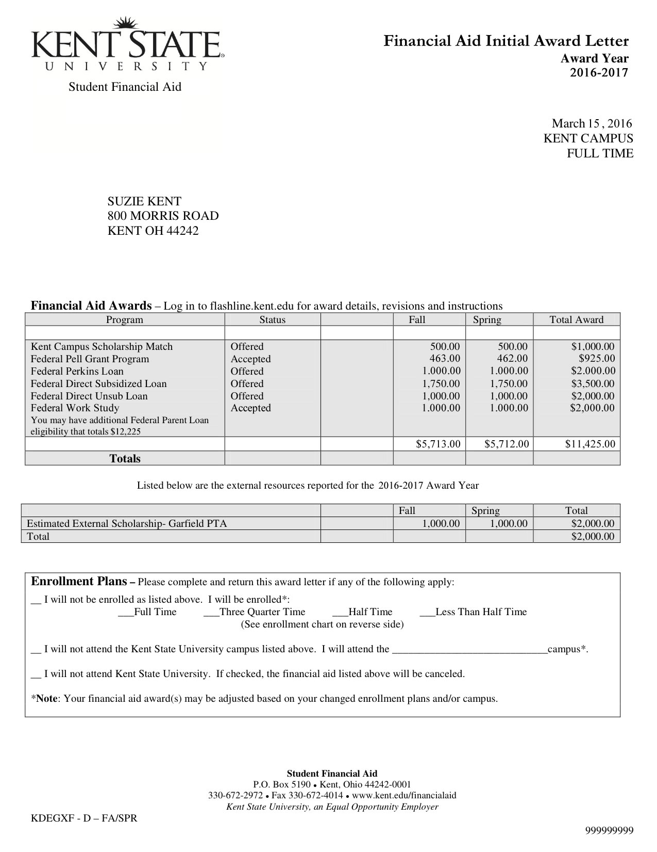
La Carta de oferta será enviada
por correo a
mediados de marzo

Slide 72
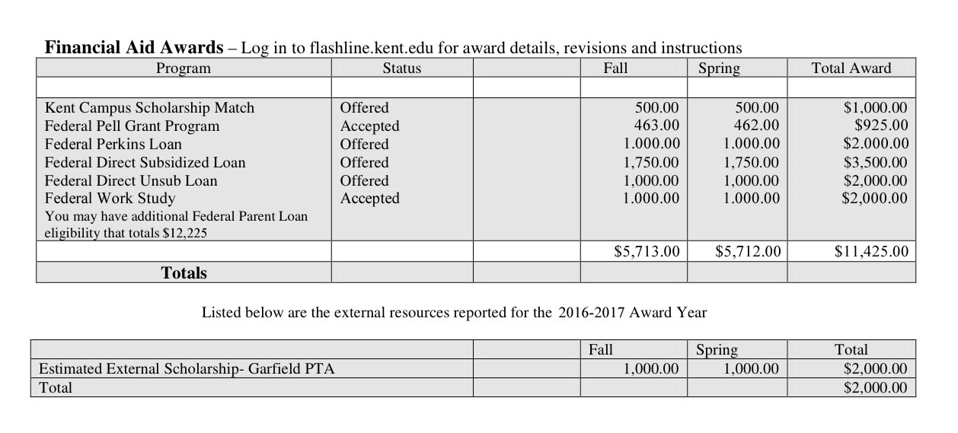

Slide 73
Costo de Educación $25,650
Asistencia Económica $13,425
Elegibilidad para un préstamo
PLUS para los padres o préstamo privado
(Require una aplición y aprovación)
$12,225

Slide 74
Proceso de pago

Slide 75
Oficina de Recaudaciones – Oficina de Facturación
www.kent.edu/bursar
Factura electrónica será publicada: 22 de julio
Fecha de vencimiento:
12 de agosto
Notes:
They are the official office that handles any billing issues such as charges, payment plans, refunds etc. We’ll review the direct cost charges and a couple of examples.
Here is a copy of the billing invoice that will be emailed to you by the Bursar’s office. They no longer mail the invoices out.
Please feel free to visit their website or give them a call at the contact information on the website.
We do have representatives here from their office. You may also feel free to visit their table with any questions.

Slide 76
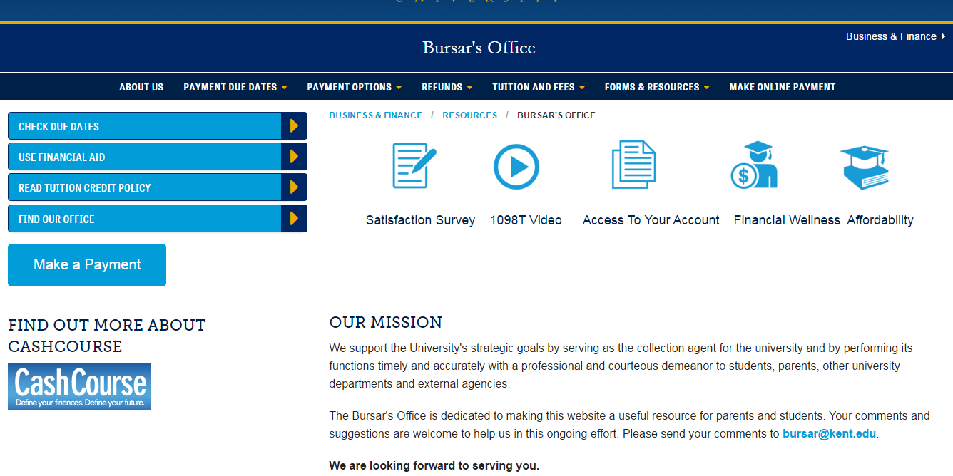
Matrícula y cuotas
Crédito por hora
Resident de Ohio/ no-residente
Recinto de Kent/ Recinto Regional
www.kent.edu/bursar
Notes:
Now we will discuss Direct cost. List the 3. The current per credit hour rate is $456 for undergrad Ohio resident. Non-Ohio is $818 per credit. Tuition is frozen for the 16-17 academic for in-state residences only. So the $456 credit hour will remain the same for 16-17.

Slide 77
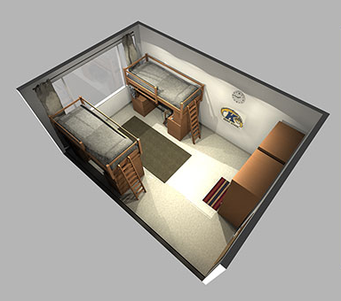
Servicios de alojamiento
Precios de las habitaciones fluctuan desde $3,168-$5,026 por semestre
Ejemplos:
Individual estándar: $3,556
Doble estándar: $ 3,232
Dos personas semi-suite
con baño compartido $4,154
Deluxe individual con baño privado$5,026
Día de mudanza: 25 de agosto
www.kent.edu/housing
Precios está basados en cantidades del año 2015-2016
Notes:
Breakdown off all room rates by residence hall is on www.kent.edu/housing. We have Residence Services reps here if you have any further questions.

Slide 78
Servicios de alimentos
Precios de los planes de alimentación fluctuan desde $1,780-$2,675 por semestre
Lite: $1,780
Básico: $1,935
Premier: $2,275
Premier Plus: $2,675
www.kent.edu/dining
Precios basados en cantidades de 2015-2016
Notes:
Meal Plan is also know as Board-plan rates/Dining plan
The website will give you a list of all meal plans with their cost and details
All roll over semester to semester, but not past the spring semester
Premier and Premier Plus roll over semester to semester, YEAR to YEAR with the purchase of another Premier or Premier Plus plan the following fall
Rates listed are for 2015-2016

Slide 79
Costos de Suzie Kent
Matrícula = cuotas institucionales:
cuotas generales:
cuota del programa (estimado) :
$4,196
$ 810
$ 100
Habitación doble estándar
Plan de alimentación básico
$3,232
$1,935
Factura total: $10,273
por semestre
Basado en cantidades de 2015-2016
Notes:
Here is an example of what your invoice may look like
Instructional Fees are all class fees
General Fees are service fees such as the recreation center
Some programs may have additional fees
Leebrick Hall in Tri-Towers has standard double rooms
Keep in mind this doesn’t include books or personal expenses

Slide 80
Pagar el saldo del semestre en su totalidad en un solo pago
Notes:
The first payment option we will talk about is the single payment

Slide 81
Ejemplo: Suzie Kent haciendo un solo pago total
Asistencia económica:
(excluye Estudio y Trabajo)
Beca Pell
Becas
Préstamo Perkins
Préstamo Subsidiado*
Préstamo No Subsidiado*
Total en asistencia económica:
$ 463
$1,500
$1,000
$1,732
$ 990
$5,685
*1.068% deducción de cuota de originación del préstamo
Notes:
Let’s take a look at an example with Suzie Kent
Let’s take a look at her award financial aid
Remember as stated before, FWS is not deducted from the bill
There is a loan fee of 1.068% - sub is interest free

Slide 82
Ejemplo: Suzie Kent haciendo un solo pago total
Factura total:
Total en asistencia económica:
(excluye Estudio y Trabajo)
$10,273
$ 5,685
Fecha límite para un solo
pago total es el 12 de agosto: $4,590

Slide 83
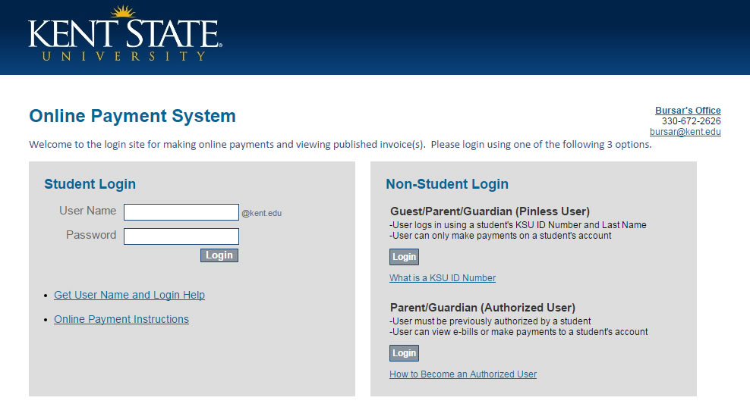
Para hacer pagos electrónicos
https://payonline.kent.edu
Notes:
If you plan on doing a single payment or making multiple payments before the due date: Here is the website.
You can log in as student or non-student
No paper bill
Bills are processed every term but not all registration activity may result in an e-bill being generated prior to due date
Flashline account summary has most up to date information Spring ebills sent in November
Can also pay in person and via mail. Directions are on the website

Slide 84
Formas de pago:
Efectivo
Discover
MasterCard
Money Orders
Visa
American Express
Diner’s Club
Cheques personales
Pagos con tárjetas de crédito o de débito se cobrará una cuota por servicio
Pagos con cuenta de cheque/ahorros o cheque electrónico no se cobrará una cuota por servicio.
Notes:
Credit/Debit card payments cannot be accepted over the phone or in person

Slide 85
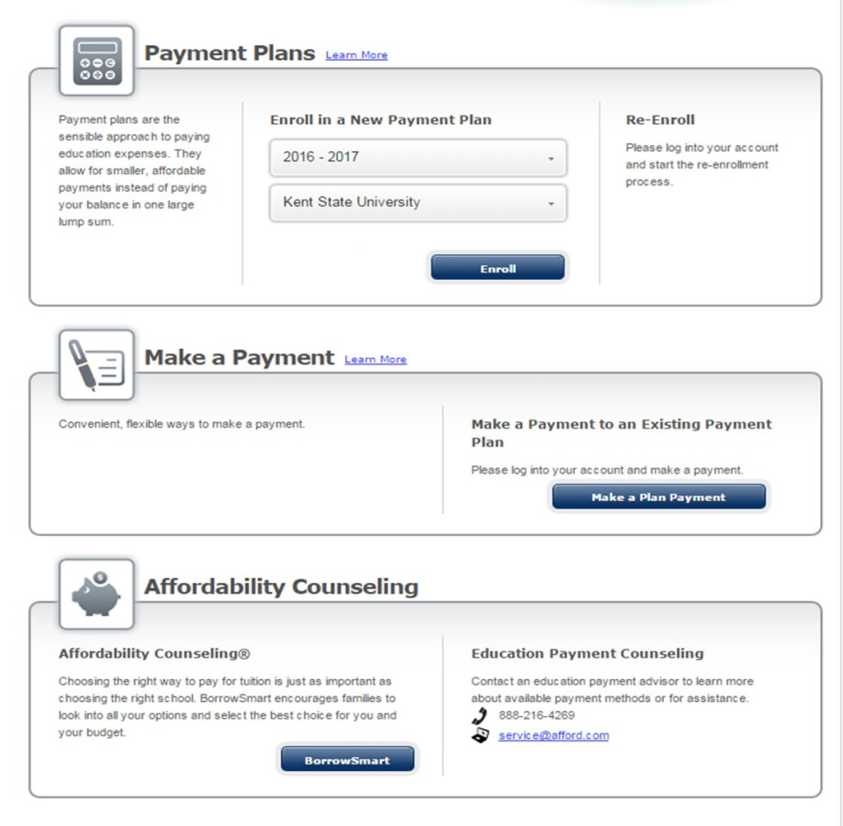
Planes de pago mensual
Matrícula, alojamiento y comida se pagará en un período de 4 o 5 meses por semestre
Affordability Counseling disponible
Coordinado por medio de Tuition Management Systems, Inc.
www.kent.afford.edu
Notes:
Next payment options we will discuss are the monthly payment plans.
Only available Fall and Spring semesters; not available in the Summer
Done via FlashLine account
If you choose this option, the due dates will be reflected on your bill

Slide 86
Opciones de planes de pago
Semestre de otoño | Fecha de inicio | Fecha final
5 meses | julio | noviembre
4 meses | agosto | noviembre
$55 tarifa de inscripción
www.kent.afford.edu

Slide 87
Opciones de planes de pago
Semestre de primavera | Fecha de inicio | Fecha final
5 meses | diciembre | april
4 meses | enero | april
$55 tarifa de inscripción
www.kent.afford.edu

Slide 88
Ejemplo: Suzie Kent usando el plan de pago de 4 meses
Factura total estimada un solo semestre:
$10,273
$ 5,685
Total en asistencia económica:
(excluye Estudio y Trabajo)
Cantidad total adeudada: $4,590
Pagos
Fecha límite del primer pago agosto 1: $1,147.50
Fecha límite del segundo pago septiembre 1 : $1,147.50
Fecha límite del tercer pago octubre 1: $1,147.50
Fecha límite del cuarto pago noviembre 1 : $1,147.50
Notes:
Here is Suzie Kent’s example if she chooses the 4 month plan.
FWS excluded
The key point is that if a student/family enrolls in the 4-month plan prior to August 1, the August payment will be due August 1st and the enrollment fee is paid at the time you enroll in the installment plan. In this example, the enrollment fee was paid prior to August 1.
If they enroll in the 4-payment plan between August 1-12, the enrollment fee and first month (August) payment is due at the time of enrollment.
Again Bursar reps are available for questions.

Slide 89
Otras opciones de pago
Kent First Payment Program
Cubre la matrícula para un programa de bachillerato
Requiere un pago inicial y 42 pagos mensuales
Planes de ahorro para la universidad
Familias reservan fondos para futuros costos universitarios
Planes 529
Notes:
Kent First Program is only for freshmen
For families who want to pay their students entire college tuition, meaning up until the year they graduate
? is the contact in the Bursar’s office for this program if you need more information.
>> Kent State University does not process billing information for 529 Prepayment College Plans. Students should contact their individual prepaid college plan for fund release requirements. If your 529 payment will not be released by the semester due date, please supply the Bursar’s Office with proof of benefits from the 529 plan in order to allow the Bursar’s Office to make sure the student’s schedule is not cancelled for non-payment.

Slide 90
Bienestar financiero
Notes:
Now that we’ve talked about charges and payment options, we will touch a little on another topic mainly administered through the Bursar’s Office.

Slide 91
Calculando el costo
1. Determine el costo total por el año
Matrícula y cuotas
Alojamiento y comida
Notes:
1. Not all residence halls cost the same
Most students can make it with the basic meal plan
Keep expenses as low as possible

Slide 92
Calculando el costo
2. Estime el costo de los libros/útiles escolares por el año
Notes:
2. Books and supplies (or personal expenses) are not included on the students bill

Slide 93
Calculando el costo
3. Reste la asistencia económica ofrecida
Incluyendo becas externas
Notes:
3. Will receive in March
There will be a worksheet included to complete these steps – Award Letter Guide

Slide 94
Calculando el Costo
Solo tome prestado lo que necesita
Notes:
5. Loan management is very important
You must repay them back, so you want to only borrow what you need
Sub vs Unsub

Slide 95
Calculando el Costo
4. Revise balance adeudado
Reste pagos personales
Inscribasé en un plan de pago mensual de ser necesario

Slide 96
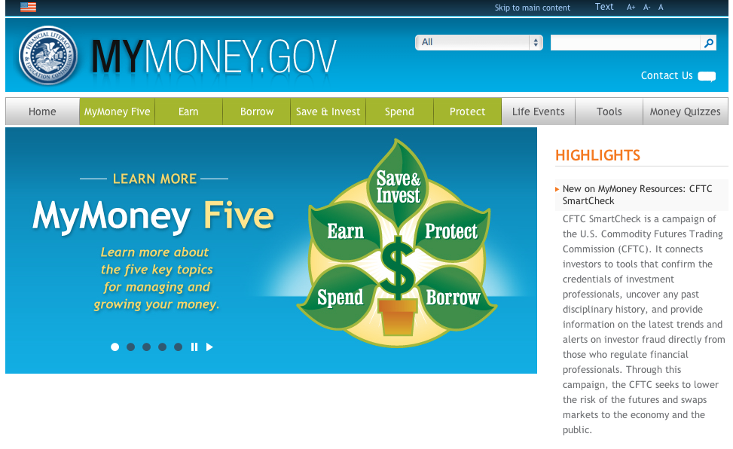
Fundamentos financieros básicos
Tomar
prestado
y gastar inteligentemente
www.mymoney.gov
Notes:
Now we will go over some resources to assist you.
www.mymoney.gov
Can help with financial basics including borrowing and spending

Slide 97
Asesoría para préstamos
www.studentloans.gov
Notes:
A tool with info that helps you understand your financial aid and finances

Slide 98
National Student Loan Data System (NSLDS)
Vista centralizada de todos los préstamos federales y becas federales que el estudiante ha usado. El estudiante puede tener acceso usando su contraseña FSA ID
nslds.ed.gov
Notes:
A list of all federal loans, amounts borrowed, institution borrowed at and lender information.
Recommend checking each semester or enrollment period

Slide 99
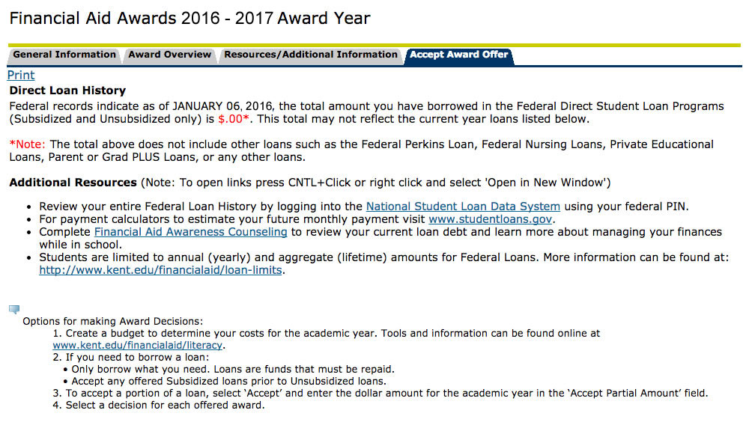
FlashLine

Slide 100
Puede ayudarle a:
Desarrollar un presupuesto y destrezas de como manejar su dinero
Como utilizar sus tarjetas de débito y crédito sabiamente
Como administrar su asistencia económica
www.cashcourse.org
Notes:
Link is provided to students on Bursar's website

Slide 101
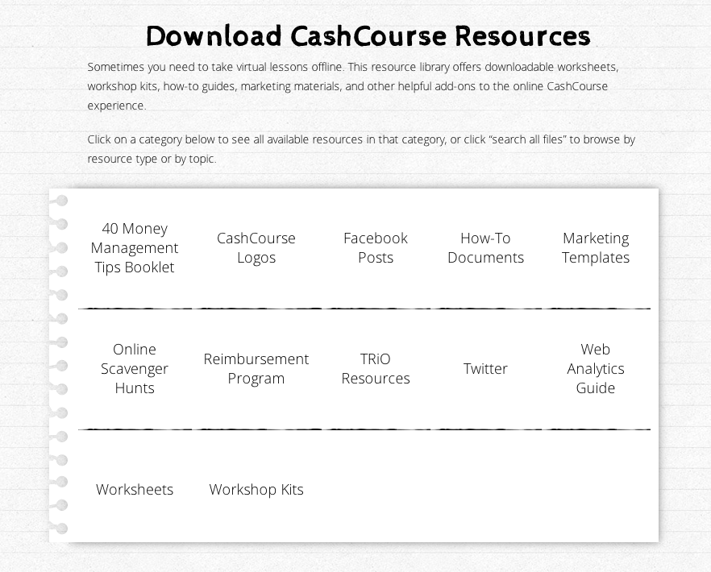
Notes:
Sample worksheets from CashCourse

Slide 102
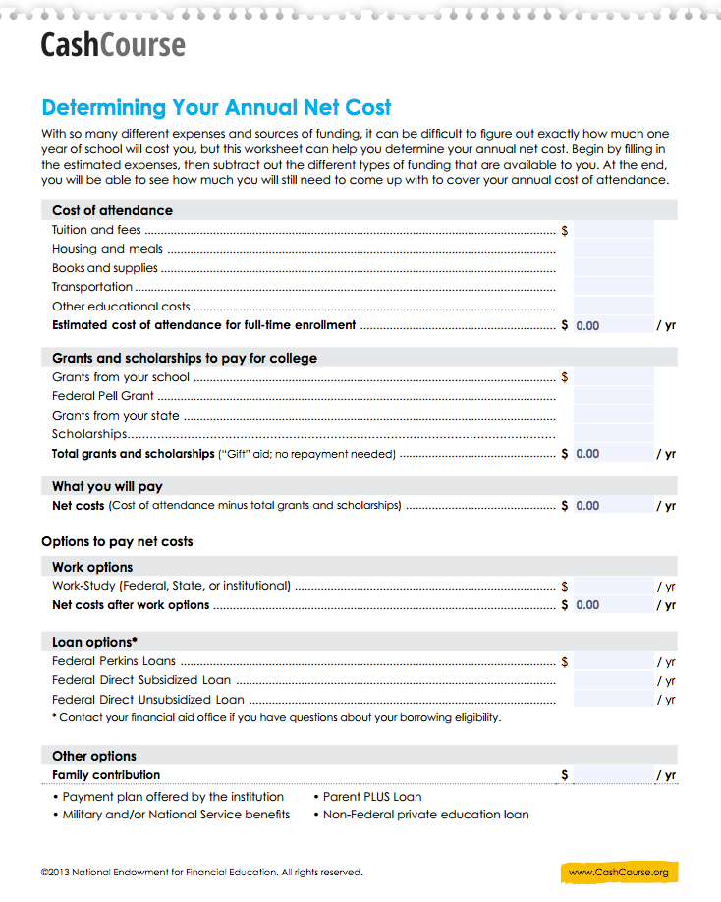
Calcular sus costos
Notes:
Gives you the opportunity to list all of your financial aid and college expenses
Very similar to the example I gave before

Slide 103
Redes sociales
Federal
Student Aid
Sigalo en Twitter
www.studentaid.gov
Notes:
Federal Student Aid web site
Do not need to click - will automatically go through social media
Will include videos, checklist and other helpful resources.

Slide 104
FAFSA en línea

Slide 105
Proceso
de
aplicación
Aplique en línea
Aplique con tiempo
Aplique todos años
www.fafsa.gov

Slide 106
Información necesaria
Numero de Seguro Social
Registros de inversiones e
inversiones bancarias
2015 Planilla de Contribución
Sobre Ingresos
y Formulario W-2
Registro de negocios y granja
Información sobre ingresos no
sujetos a impuestos

Slide 107
FSA ID
Federal Student Aid ID
fsaid.ed.gov
Reemplaza el PIN (Personal Identification Number)
Notes:
Student and at least one parent must apply ; FSA ID stays the same from year to year; If parent is a student and has an FSA ID this is the same FSA ID that will be used. PINs are no longer used unless you had one previously. You would then be asked to provide it when creating your new FSA ID

Slide 108
Usar su credencial FSA ID
Firmar, renovar, y corregir su FAFSA electronicamente
Firmar su Pagaré Maestro
electronicamente
fsaid.ed.gov
Notes:
Can access through www.fafsa.gov

Slide 109
Completar la FAFSA

Slide 110
Solicitud Gratuita de Ayuda Federal para Estudiantes
www.fafsa.ed.gov

Slide 111
Planilla de
Preparación
para
FAFSA on
the Web
Notes:
In your packet you have a FAFSA on the Web worksheet
FAFSA on the Web Worksheets are provided to help you prepare to complete the FAFSA online. We suggest you use this worksheet to write your answers down so that you can easily transfer the data from the worksheet to the Web when you begin completing the FAFSA online.

Slide 112
FAFSA on the Web
(FAFSA en línea)
Las modificaciones incorporadas evitan errores
Skip-logic remueve preguntas innecesarias
“Orientacion y consejos”
Instrucciones detalladas y ayuda
para preguntas comunes

Slide 113
Se compone de
5 secciones
Incluye la sección de los padres y
la sección del estudiante
Notes:
The Help and Hints box is really helpful. It pops up for every screen and gives helpful information on how to answer the questions correctly.
cont.
Can also apply for a PIN at this point

Slide 117
Estudiantes con créditos universitarios
“¿Cual sera su nivel de estudio cuando comienze el año académico2016-2017?”
Primer año
Segundo año
Tercer año
0-29.99 créditos por hora
30-59.99 créditos por hora
60-89.99 créditos por hora
Pregunta #29 en la FAFSA
Notes:
Post secondary students - high school students who have completed college coursework

Slide 118
Debe introducir el nombre de la escuela, la ciudad y el estado en donde se encuentra la escuela

Slide 119
Puede añadir
hasta
10 instituciones
educativas

Slide 120
Puede añadir
hasta
10 instituciones
educativas

Slide 121
Alojamiento

Slide 122
Dependiente
o
independiente

Slide 123
Si el estudiante no puede contestar “sí”
a ninguna de estas preguntas, el estudiante deberá incluir la información de los padres
Notes:
DEPENDENCY STATUS: The purpose of these questions are to determine, for financial aid purposes, whether your student is a dependent or an independent student READ THE CHOICES.
If the student answers “No” to all of these questions, he or she is a considered a dependent student, even if he or she does not or will not live with the parents. A dependent student continues on and provides information about his or her parents in the area designated for parental income on FAFSA on the Web.

Slide 124
Estudiantes que no puedan proveer
la información de los padres, deberán contactar su consejero (a) de asistencia económica
Notes:
Complicated family situations. Raised by adults other than parents, left home due to extreme circumstances…..

Slide 125
Información de
los padres

Slide 126
www.studentaid.gov
Notes:
PARENT INFORMATION; “ Who is considered a parent?” Parent refers to a biological or adoptive parent. Grandparents, foster parents, legal guardians, older siblings, and aunts and uncles are not considered parents for financial aid purposes unless they have legally adopted the student. If you are living with and/or being raised by someone other than your parents please see one of the financial aid representatives before you leave today. If your parents are both living and married to each other, answer the questions about both of them. In case of divorce or separation, give the information about the one biological or adoptive with whom you live. If your biological or adoptive parents has remarried you will provide information about that parent and your stepparent with whom you live. If you live between divorced parents equally, give information abut the parent who provided the most financial support during the last year.

Slide 127
Datos demográficos
de los padres
Notes:
Once we have established “the parent”, there will be a series of questions asked about the parents. questions about the parents’ Social Security number last name, first initial and date of birth.

Slide 128
Datos demográficos
de los padres
Notes:
Household size – include others who live in the same household and are being supported at least 51%
do not include siblings who are in US Military

Slide 130
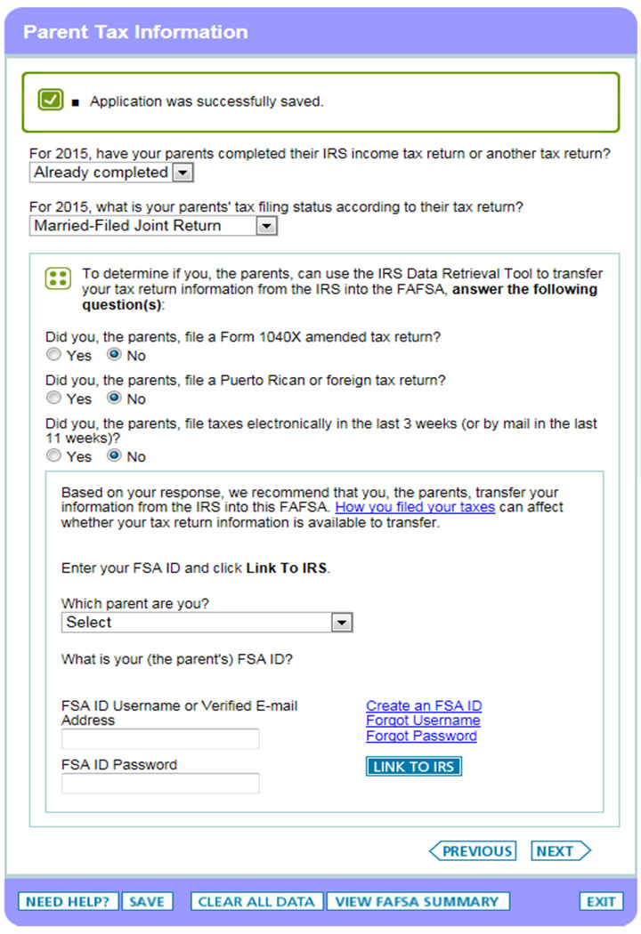
Herramienta de consulta y traspaso de datos del IRS
(IRS Data Retrieval Tool)
disponible
7 de febrero del 2016
Notes:
Indicate whether your parents have already completed, are going to complete, or will not file a tax return for 2015.
Based on the answers to the questions on this page, the system will determine if the parent is eligible to use the IRS data retrieval tool.
Cannot be used if:
Parents are married but filing separately
There is a change in marital status after taxes are filed
IRS information available within 1-2 weeks for electronic filers or 6-8 weeks for paper tax
Filers
Will not be available until early-mid February for anyone

Slide 131
Herramienta de consulta y traspaso de datos del IRS
Le permite transferir electrónicament a la FAFSA la información de su declaración de impuestos federales

Slide 132
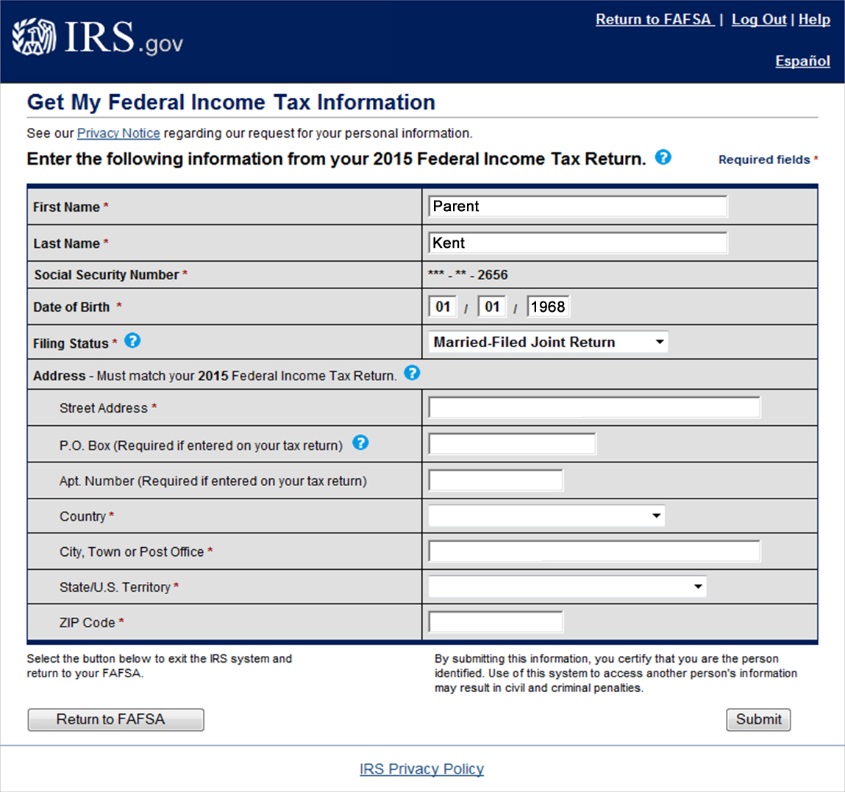
Notes:
The screen no longer is part of the FAFSA website but the parent has been transferred to the IRS website where they will be asked to provide information in order to display their correct tax information.
This screen demonstrates the information available once the request for information has been submitted. As you can see, the parent still has the option to not have the information transferred should they decide to change their mind.

Slide 133
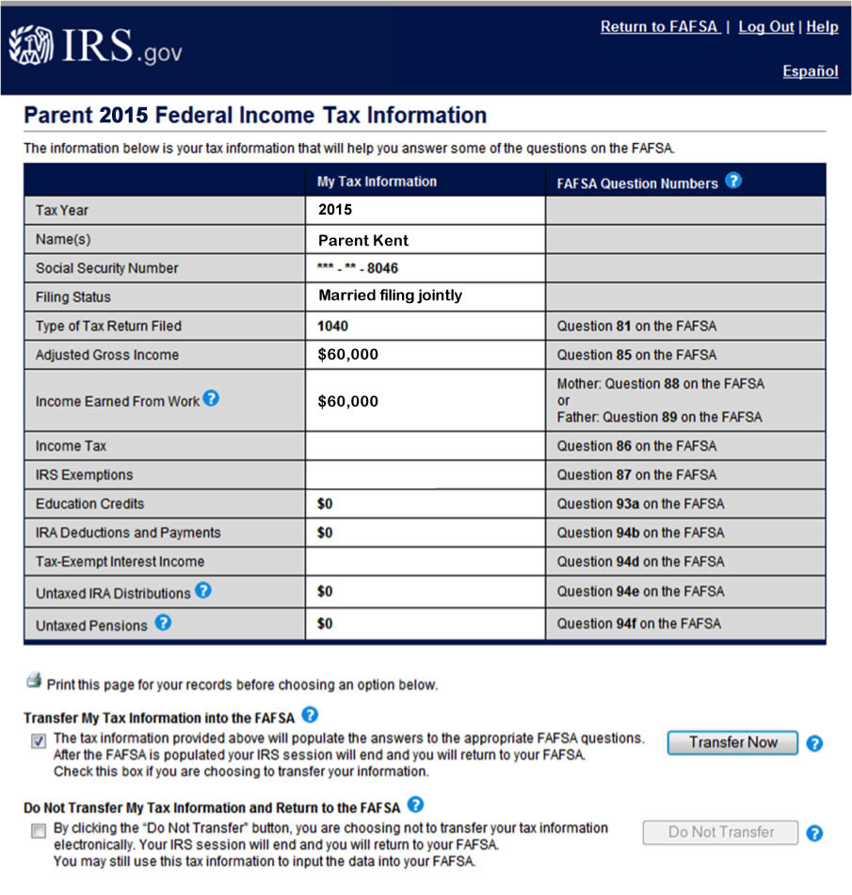
Notes:
As you can see, the parent still has the option to not have the information transferred should they decide to change their mind.

Slide 134
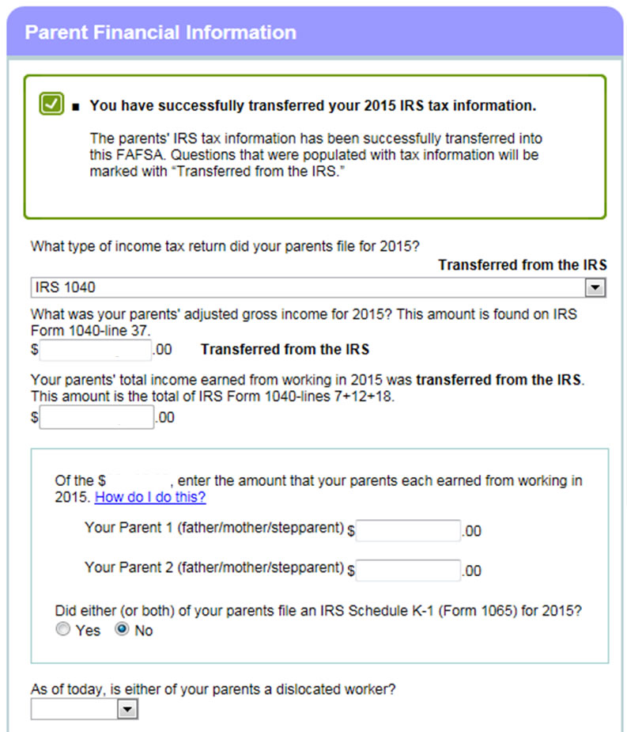
Si el padre o el estudiante no es elegible para usar la Herramienta de consulta y traspaso de datos del IRS, deberá entrar la información manualmente
Notes:
Please check if that parent is a Dislocated Worker. In general, a person may be considered a dislocated worker if he or she
• is receiving unemployment benefits due to being laid off or losing a job and is unlikely to return to a previous occupation;
• has been laid off or received a lay-off notice from a job;
• was self-employed but is now unemployed due to economic conditions or natural disaster.
If that question is checked you may be eligible to file a Special Circumstances Application. It is process that will allow us to consider the loss of income in your household that this application will not. The spec. cir app process will ask you to provide necessary documents of proof. The spec. cir app will be available after March 31. You must answer the income questions correctly as they are presented.
(How to complete the income tax section) It is best to use a completed 2015 income tax return to fill out this application. However, if your parents do not have a completed income tax return, they should calculate their adjusted gross income (AGI) and taxes paid. Even if your parents are not required to file a 2015 income tax return, they will need to calculate their earnings for the year. Use W-2 forms and other records to answer the questions in this section. If an answer is zero or a question does not apply to your parents, enter 0 (zero). Do not leave any of these questions blank.

Slide 135
Información de ingresos no tributables y los activos
Notes:
Additional Financial Information and Untaxed Income: IF YOU CHECKED ANY OF THE BOXES YOU WILL BE EXPECTED TO INCLUDE A DOLLAR AMOUNT. MOST OF THE DOLLAR AMOUNTS CAN BE FOUND ON A W-2 FORM OR ON A SPECIFIC LINE ON A TAX FORM.

Slide 136
Información de ingresos no tributables y los activos
Notes:
Some families may be asked to answer asset questions
An asset is defined as property that has an exchange value. To determine the net value of any asset, you first determine the market value of the asset and reduce the value by the amount of debt against that asset. The result is the net value of the asset. Some examples of assets that are NOT reported:
• Principal place of residence/family farm. Your parents’ principal place of residence is not reported as an asset. Neither is their family farm if the farm is their principal place of residence and they “materially participated in the farm’s operation.” Do not report possessions such as a car, a stereo, clothes or furniture. By the same token, personal debts such as credit card debt cannot be reported. Pensions, 401K, 403B and Whole Life Insurance. The cash value or built-up equity of a life insurance policy.
• A small business with 100 or fewer employees. If your family owns and controls more than 50 percent of a small business that has 100 or fewer full-time or full-time equivalent employees, do not report the net value of the business as an asset.
Net worth of business and/or investment farm. Business or farm value includes the current market value of land, buildings, machinery, equipment, inventory, etc.
Business/Farm Value – Business/Farm Debt = Net Worth of Business/Farm
For business or investment farm value, first figure out how much the business or farm is worth today. An investment farm is a farming business where the parents do not reside on the farm, nor do they materially operate the farm.
Business or investment farm debts are what your parents owe on the business or farm. Subtract the amount of debt from the value. Indicate this amount for net worth of business and/or investment farm.

Slide 137
Información de ingresos no tributables y los activos
Notes:
EXAMPLES OF ASSETS ARE: RENTAL PROPERTIES, TRUST FUNDS, INVESTMENTS SUCH AS 529 College Savings Plan and Prepaid Tuition Plans. Investments also include Uniform Transfers to Minors Act (UTMA)/Uniform Gifts to Minors Act (UGMA) Custodial Accounts, money market funds, mutual funds, certificates of deposit, stocks, stock options, bonds, other securities, Coverdell savings accounts owned by your parents. Your parents must report all qualified educational benefits or education savings accounts that they own for any member of the household. This includes accounts owned by the dependent student.

Slide 138
Planes 529 & matrícula prepagada
Se trata igual que los fondos de inversión, CD’s y otras inversiones
Si el estudiante es dependiente
el Plan 529 es un activo de los padres

Slide 139
Información del estudiante
Preguntas sobre información financiera son las mismas que se le hacen a los padres
Notes:
After parent information is student information
Student can also use IRS Data Retrieval Tool
For our example, we are using Suzie Kent

Slide 140
Introduzca el salario incluso si el estudiante no presentó una declaración de impuestos
Notes:
All students must provide their financial information for these questions. Even if you are not required to file a 2015 income tax return, you will need to calculate your earnings for the year. Use W-2 forms and other records to answer the questions in this section.
Student’s income earned from working. Enter your 2015 income earned from work (wages, salaries, tips). The amount reported here will receive certain income allowances (deductions) from your income for necessary expenses.

Slide 141
Información de ingresos libres de impuestos y activos
Notes:
Money received or paid on your behalf - Includes money paid from 529 plan, not owned by the student or parent

Slide 142
Firmar y
enviar la FAFSA
Notes:
Both parent and student

Slide 143
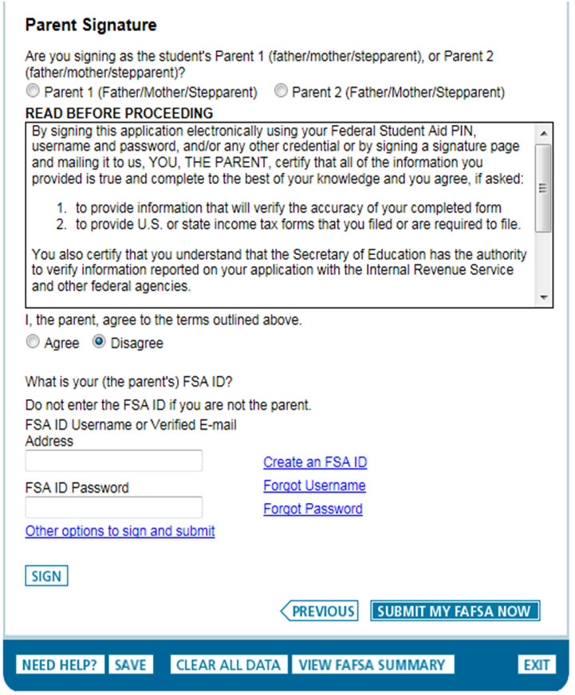
Firmar y
enviar la FAFSA
con la credencial
FSA ID
Notes:
Print for your records; CONFIRMATION #, EFC , PRELIMINARY INFORMATION REGARDING GRANTS AND LOANS
Optional feature- Transfer your parents information into another FAFSA

Slide 145
Errores frequentes en la FAFSA
Número de Seguro Social
Fecha de nacimiento
Información de los padres casado/nuevas nupcias
Impuestos sobre la renta pagados
Integrantes de la familia que viven en el hogar
Ingresos obtenidos por los padres
Bienes inmuebles y el valor neto de inversión

Slide 146
Verificación
Se asegura de que el estudiante reciba la cantidad correcta de asistencia económica en el momento adecuado
No es un proceso opcional
www.kent.edu/financialaid
Notes:
Verification is a federal requirement where the institution request copies of tax forms and W2‘s to verify the information provided on the FAFSA .
Ensures that eligible students receive all the financial aid that they qualify for.
Prevents ineligible students from receiving aid they are not eligible for.
If do not use data retrieval, increases chances of being selected for the verification process.

Slide 147
Circunstancias especiales
Cambio en las circunstancias financieras de la familia
Perdida de ingresos/beneficios
Divorcio/separación
Gastos de matrícula escuela elemental/secundaria
Padre en la univesidad

Slide 148
FAFSA 2017-2018
Presentar tan pronto el 1ro de Octubre del 2016
Use la información sobre ingresos de 2015
No tendrá que estimar– use el IRS Data Retrieval Tool
Permite más tiempo para explorar opciones de asistencia económica
www.studentaid.gov

Slide 149
¡Gracias!

